Slide 1

Let’s start with Allah Yaar
Bs in Computer Science

Slide 2
The World Wide Web
The World Wide Web
Detailed Definition:
The Web is a global information medium where users can read and write via computers connected to the Internet.
It operates as a client-server model:
The client (browser) requests a resource.
The server (hosting the resource) responds to the request.

Slide 3
The World Wide Web
Key Features:
Hypertext: Links that connect different pages.
Multimedia: Supports images, videos, and audio.
Accessibility: Resources can be accessed from anywhere with an Internet connection.
Real-Life Example:
A student searches for academic papers on Google Scholar and accesses a PDF file hosted on a university server.

Slide 4
Overview of the World Wide Web
Components:
Websites: Collections of web pages (e.g., www.example.com).
Browsers: Tools for accessing the Web (e.g., Chrome, Firefox).
Web Servers: Store and deliver web resources (e.g., Apache, Nginx).

Slide 5
Overview of the World Wide Web
Benefits:
Instant Information Access: Users can search for information on any topic.
Interconnectivity: Links enable navigation between different resources.
Historical Perspective:
Before the Web: Information exchange relied on systems like ARPANET.

Slide 6
Overview of the World Wide Web
After the Web: The introduction of graphical user interfaces made browsing accessible to non-technical users.

Slide 7
The Distributed Web
Detailed Concept:
Aims to remove reliance on central servers to avoid censorship and increase resilience.
Files are stored on multiple computers (nodes), ensuring accessibility even if some nodes fail.

Slide 8
The Distributed Web
Key Technologies:
Blockchain:
Example: Bitcoin transactions are stored in a decentralized ledger.
IPFS (Interplanetary File System):
Example: Sharing a video without needing YouTube; files are stored across multiple systems.

Slide 9
The Distributed Web
Advantages:
Enhanced privacy and security.
Resilience against server outages or attacks.

Slide 10
The Addressable Web
How URLs Work:
A URL consists of:
Protocol: Determines the method of communication (e.g., http, https).
Domain Name: Identifies the web server (e.g., www.example.com).
Path: Specifies the exact resource (e.g., /products).
Query Parameters: Additional data for processing (e.g., ?id=123).

Slide 11
The Addressable Web
Example:
URL: https://www.example.com/shop?item=book
Protocol: HTTPS ensures secure communication.
Domain: www.example.com points to the web server.
Path: /shop points to the shop page.
Query: item=book specifies the search for a book.

Slide 12
The Linked Web
Detailed Working:
Hyperlinks are the backbone of the Web, created using <a> tags in HTML.
Example of a link: <a href="https://www.wikipedia.org">Visit Wikipedia</a>.
Links can connect:
Internal pages (within the same site).
External pages (on different websites).

Slide 13
The Linked Web
Significance:
Search engines like Google rely on links to discover and rank pages.
Example: A blog post about "Healthy Eating" might link to scientific studies for credibility.

Slide 14
The Protocols of the Web
Expanded Protocols:
HTTP (Hypertext Transfer Protocol):
Transfers data in plain text.
Example: Visiting an unencrypted website like http://example.com.
HTTPS (HTTP Secure):
Encrypts data for secure communication.
Example: Used for online banking.

Slide 15
The Protocols of the Web
FTP (File Transfer Protocol):
Transfers large files between a client and server.
Example: Uploading website files to a hosting server.
DNS (Domain Name System):
Translates domain names into IP addresses.
Example: When you type www.google.com, DNS resolves it to an IP like 142.250.64.78.

Slide 16
The Protocols of the Web
Significance:
These protocols ensure seamless and secure data exchange across the Web.

Slide 17
The Searchable Web
Expanded Details:
Search Engines:
Use web crawlers to scan and index websites.
Example: Google's crawler, Googlebot, analyzes pages for keywords.
Search Algorithms:
Rank pages based on relevance and authority.
Example: Pages with more backlinks rank higher.

Slide 18
The Searchable Web
The "Deep Web":
Part of the Web not indexed by search engines.
Example: Medical databases, academic journals.
Real-Life Example:
Searching "history of the Internet" retrieves articles, videos, and infographics related to the topic.

Slide 19
The Languages of the Web
Expanded Details:
HTML (HyperText Markup Language):
Structures content with tags.
Example: <table> for creating a table, <img> for adding images.
CSS (Cascading Style Sheets):
Defines styles like colors, fonts, and layouts.
Example: Changing font size: h1 { font-size: 24px; }.

Slide 20
The Languages of the Web
JavaScript:
Adds interactivity and automation.
Example: Validating a form before submission.
PHP (Hypertext Preprocessor):
Handles server-side tasks like form submissions or database queries.
Example: A contact form sends user data to the server.

Slide 21
The Languages of the Web
Python:
Backend scripting for web development.
Example: Building APIs with Flask or Django frameworks.
SQL (Structured Query Language):
Manages databases.
Example: SELECT * FROM Users WHERE Age > 30; retrieves users older than 30.

Slide 22
The Languages of the Web
XML and JSON:
For data transfer between systems.
Example: JSON response for an API: { "name": "John", "age": 25 }.

Slide 23
The Languages of the Web
Use HTML to create the structure:
html
<h1>Welcome to My Website</h1>
<p>Here is some information</p>

Slide 24
The Languages of the Web
Use CSS for styling:
h1 { color: green; }
p { font-family: Arial; }

Slide 25
The Languages of the Web
Use JavaScript for interactivity:
alert("Welcome to my site!");

Slide 26
The Languages of the Web
Conclusion
The World Wide Web operates through interconnected technologies and standards.
Each aspect (distributed systems, addressing, linking, protocols, and languages) contributes to a seamless user experience.
A deep understanding of these topics enables students to explore and create web solutions effectively.

Slide 27
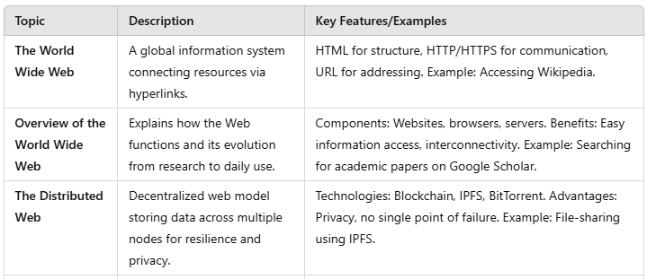
Summary Table

Slide 28
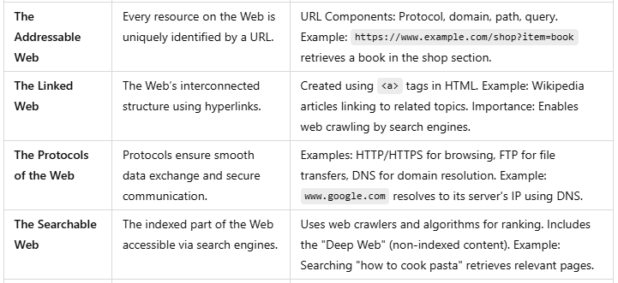
Summary Table

Slide 29
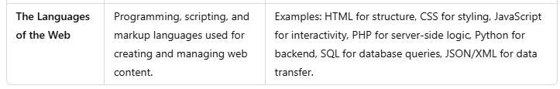
Summary Table

